Slide 1


MYNTRA
Presented To: Presented By:
Mrs. Arti Lakhanpal & BCA2-A Khushant Jindal

Slide 2

LIST OF CONTENTS
Introduction
History
Features
Awards and Recognitions
Data Structure in Myntra
Operations & Algorithms
Latest News
Conclusion

Slide 3
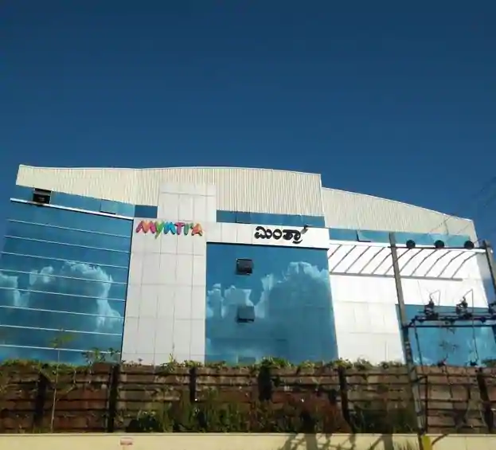
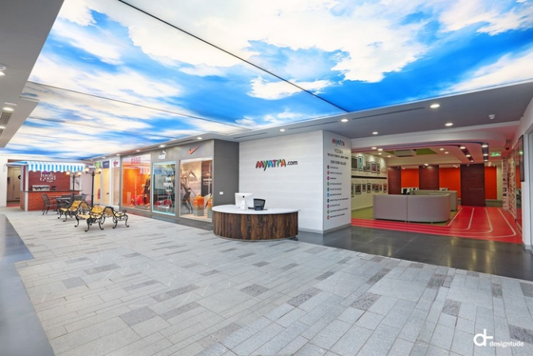
INTRODUCTION
Major Indian fashion e-commerce company
Headquartered in Bengaluru
Acquired by Flipkart

Slide 4
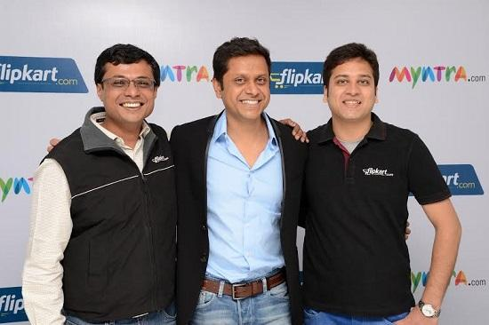
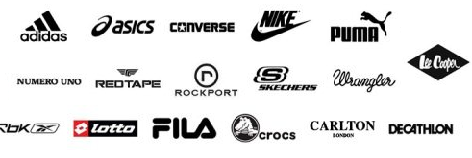
HISTORY
Established by Mukesh Bansal, Ashutosh Lawania and Vineet Saxena
Personalize products such as T-shirts, mugs, mouse pads
Offered products from 350 brands

Slide 5



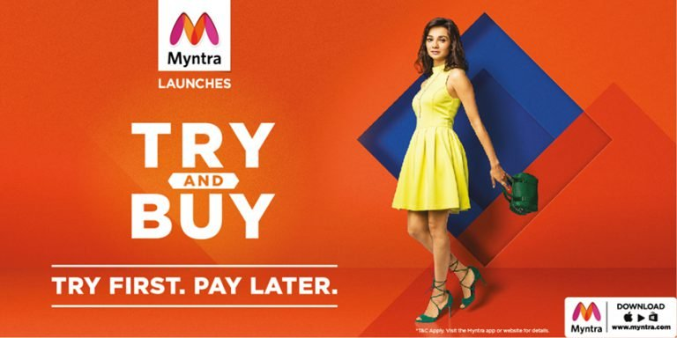
FEATURES
Follow Famous Brands & Bloggers
Easy Secure Ordering, Instant Cancellation
Sharing Made Easy In Social Apps
Try and Buy

Slide 6
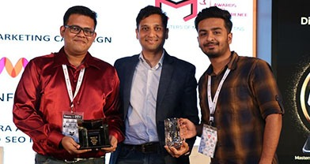
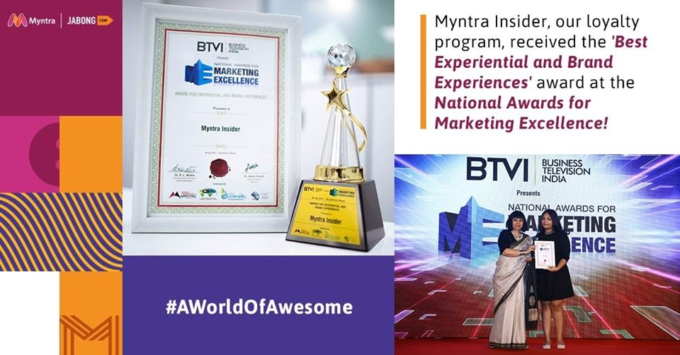
AWARDS & RECOGNITIONS
'Fashion eRetailer of the Year 2013' by Franchise India
'Best E-commerce Website for 2012' by IAMAI – India Digital Awards
'Best E-commerce Partner of the year 2011-12' by Puma India

Slide 7
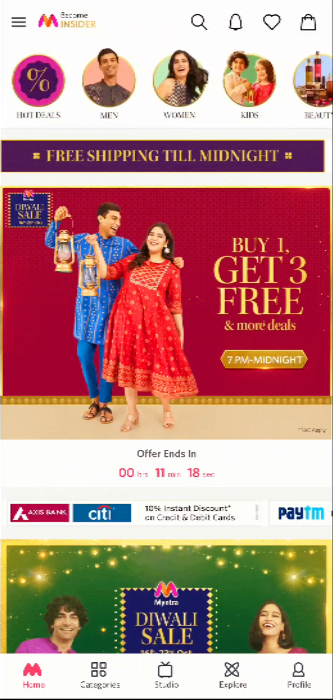
DATA STRUCTURE IN MYNTRA
TREE DATA STRUCTURE
GRAPH DATA STRUCTURE

Slide 8
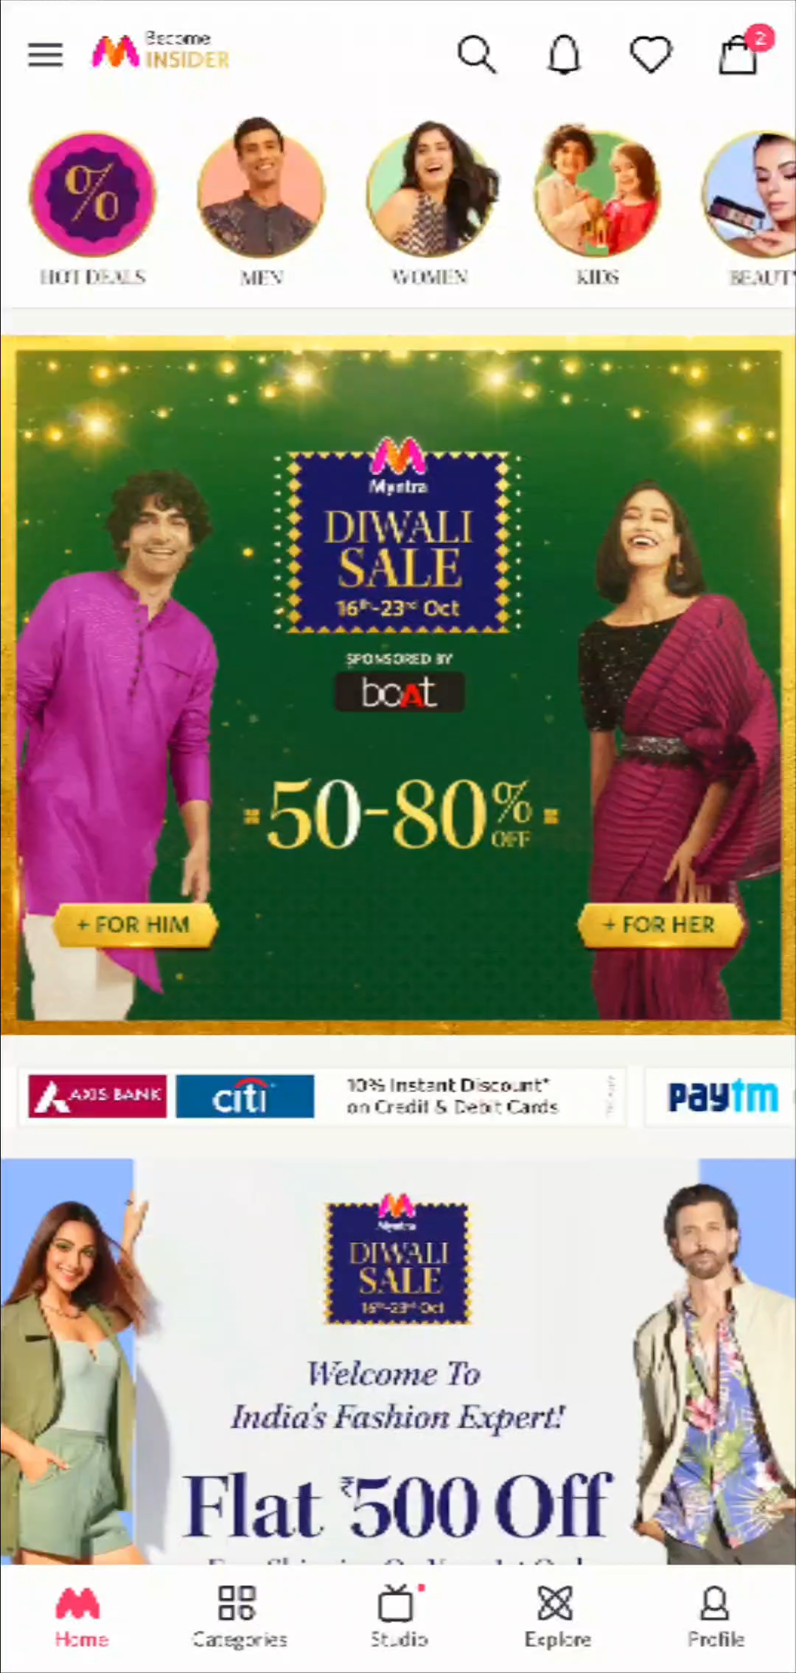
OPERATIONS & ALGORITHM
SEARCHING
SORTING

Slide 9


LATEST NEWS
Myntra concludes its festive sale with record 52 million visitors, 8 million orders
Myntra posed to become India's largest beauty and personal care player

Slide 10
CONCLUSION
Marketing and Sales is a core activity
100% authentic products, cash on delivery and 30 day return policy

